Slide 1
Getting Inside the Virtual Machine with EC2 and VPC

Slide 2
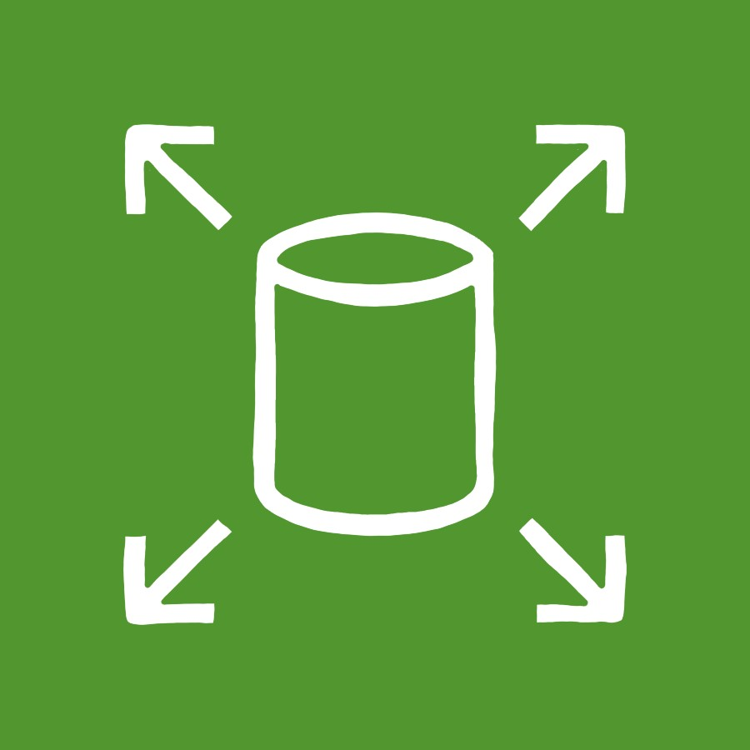



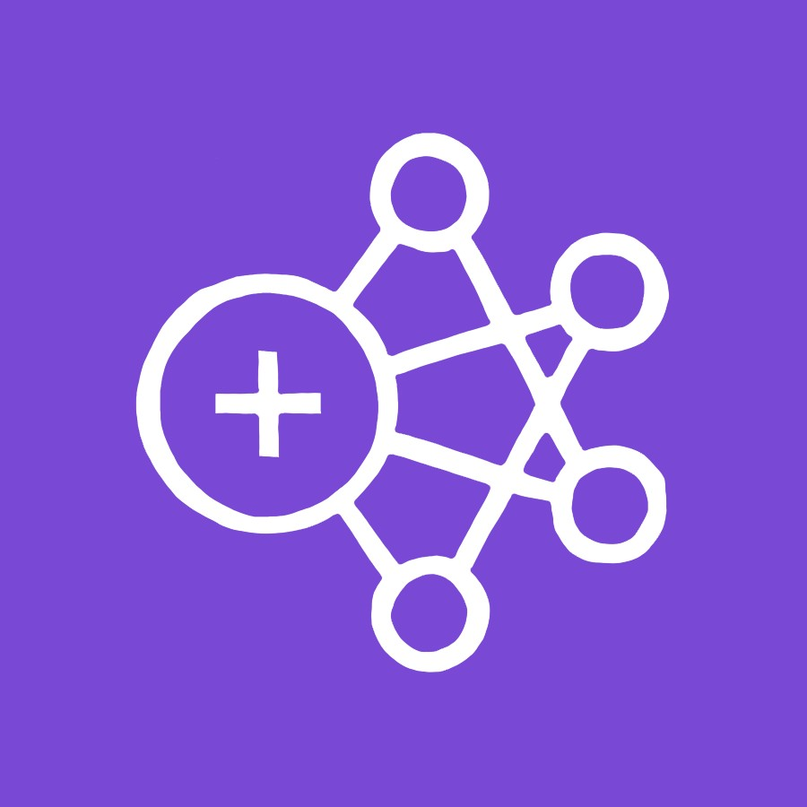

Services That Utilize EC2
Elastic Block Store
Relational Database Service
Elastic Beanstalk
Redshift
Elastic MapReduce
ElastiCache

Slide 3
Elastic Compute Cloud
Virtual machine service that runs software of your choice

Slide 4
Elastic IP
EC2 Additional
Features
Load Balancers
Auto Scaling Groups

Slide 5
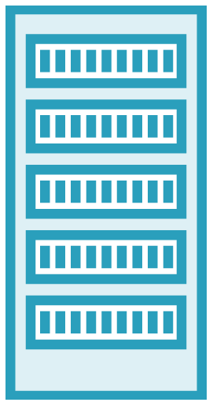

Virtual Private Cloud
x
VPN
EC2
Instance
RDS
Database

Slide 6

VPC security blanket
Everyone gets a subnet!
Overview

Slide 7
Virtual Private Cloud Overview

Slide 8
The Known Internet
Amazon Web Services
Your VPC

Slide 9
Example VPC IP Range - 10.0.0.0 - 10.0.255.255
10.0.0.1
10.0.0.3
10.0.0.2

Slide 10
VPC is free!

Slide 11
Security Group
Defines allowed incoming/outgoing IP addresses and ports. Kind of like a mini-firewall.

Slide 12
Security Groups

Slide 13
Routing Table
127.34.23.44
127.34.23. 10.0.0.4
10.0.0.4
44
10.0.0.1
10.0.0.2
10.0.0.3
10.0.0.4

Slide 14


Network Access Control List
127.34.23.44
127.34.23.44
128.34.22.34
10.0.0.1
10.0.0.2
10.0.0.3
10.0.0.4

Slide 15
Virtual Private Cloud
Subnet
Subnet
Routing Table
Routing Table
Network Access Control List
Network Access Control List
10.0.0.1
10.0.0.2
10.0.1.1
10.0.1.2

Slide 16

Public and Private Subnet Configuration
Private Subnet
Public Subnet
NAT
Gateway

Slide 17
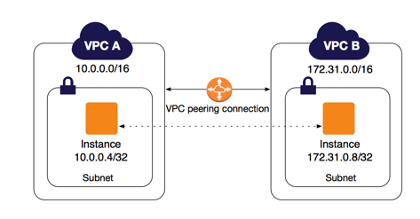

Slide 18
Creating a Virtual Private Cloud

Slide 19
Demo
Create a VPC and subnets

